Slide 1
Notice Writing

Slide 2
Points to note
A notice is a written or printed announcement.
It is written in order to inform a large number of people about something that has happened or is about to happen.
It could be an upcoming event, competition or just a piece of information to be delivered to the targeted audience.
It is generally written in a formal tone.
5. Notices are factual and to-the-point.
6. The language used is simple and formal, not flowery.

Slide 3
Format
The format of a notice should include:
NAME OF THE INSTITUTION / ISSUING AUTHORITY / NOTICE / TITLE, DATE, and WRITER’S NAME WITH DESIGNATION.
A notice should contain all the necessary details such as:
Name of the issuing agency (school, etc)
Date of issue/release of the notice
Title/Subject of the Event (what?)
BODY-Date/time/duration/Place/Venue (when and where?)
Authorized signatory: Name and signature (contact details)

Slide 4
Format
Name of the issuing agency/authority
NOTICE
Date of issue/Release of the notice
Title/Subject of the Event
BODY
(Details: Date of event /time /duration /Place /Venue etc)
Authorized signatory
(Name, Designation and signature)

Slide 5
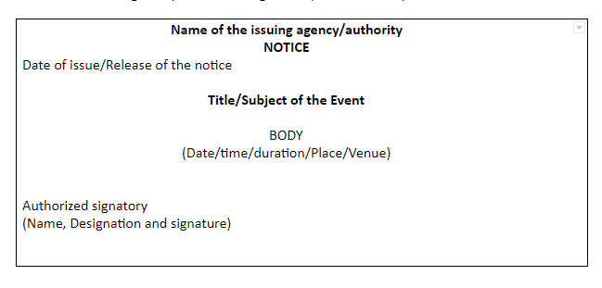
Format

Slide 6
Notice writing Tips
Do not cross the word limit to avoid penalty of marks. The prescribed word limit is 50 words.
Repetition of any information should be avoided.
Always enclose the notice in a box. Make sure you draw the box with a pencil.
Keep your notice short, crisp and to-the-point.
Highlight the word “NOTICE” and “TITLE”. It can be either bold or underlined.
The title should be captivating and eye-catching.
Don’t make hypothetical information and facts. Make use of what’s given in the question.
Make sure you do not mention your personal information.
Make use of all the available information in the question.
Your answer shall include answers to all the 5 W’s – What, Why, When, Where and Who.
The purpose for which it is being written should be stated clearly.
Focus on presentation and clarity.

Slide 7
Q. Water supply will be suspended for eight hours (10 am to 6 pm) on 6th of March for cleaning of the water tank. Write a notice in about 50 words advising the residents to store water for a day. You are Aman Kumar, Secretary, CDT Housing Society, Patna
CDT Housing Society, Patna
NOTICE
March 01, 201X
ATTENTION!
It is to inform all the residents regarding the suspension of water supply for 8 hours. It is being done to clean the water tanks. The details are as follows:
DATE- March 6
TIME- 10am – 6 pm
Thus, it is requested to all the residents to store the required amount of water beforehand to avoid any difficulty.
Thank you
Aman Kumar
Secretary

